Slide 1
Chapter 1
Recurrent Problem

Slide 2

Lines in the Plane
Given: A two-dimensional plane and n straight lines (whose both ends extend infinitely)
Rules: Place the n lines in whatever way you like.
Problem: What is the maximum number L_{n} of regions defined by the n lines in the plane?

Slide 3
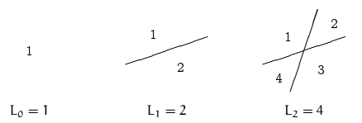
Strategy:
LOOK AT SMALL CASE FIRST
Guess the closed form……………..
You might think it is 2^{n}??
Let’s see some bigger case.

Slide 4
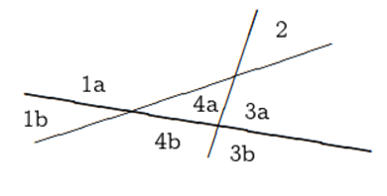


Determine Recurrence Eqn.
Suffice:
The n^{th} line (for n > 0) increases the number of regions by k if and only if it splits k of the old regions, and
it splits k old regions if and only if it hits the previous lines in k − 1 different places.
Two lines can intersect in at most one point. Therefore the new line can intersect the n−1 old lines in at most n−1 different points, and we must have k ≤ n.
We have established the upper bound

Slide 5


Determine Recurrence Eqn.
Necessity:
We simply place the n^{th} line in such a way that it's not parallel to any of the others (hence it intersects them all), and such that it doesn't go through any of the existing intersection points (hence it intersects them all in different places). I.e.
Hence, the recurrence equation is is,

Slide 6
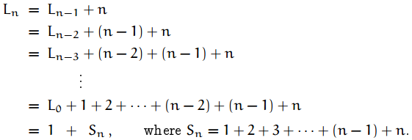


Determine the Closed Form
Here,
Now,
Or,

Slide 7

The Solution

Slide 8
Practice Problem
Prove the closed form of L_{n} using Induction Method.

Slide 9
Bent Lines in the Plane
What if we use bent lines instead of straight lines??

Slide 10
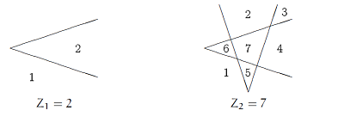
Bent Lines in the Plane
Given: Suppose that instead of straight lines we use bent lines, each containing one “zig”.
Problem: What is the maximum number Z_{n} of regions determined by n such bent lines in the plane?

Slide 11
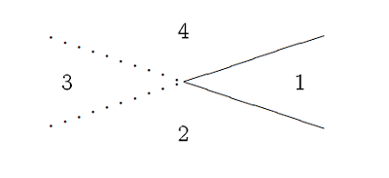
Bent Lines in the Plane
From these small cases, and after a little thought, we realize that a bent line is like two straight lines except that regions merge when the “two" lines don't extend past their intersection point.
Regions 2, 3, and 4, which would be
distinct with two lines, become a
Single region when there's a bent
line; we lose two regions.

Slide 12

So, The Solution

Slide 13
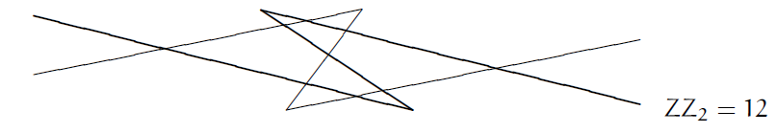
Practice Problem
What is the maximum number regions definable by n zig-zag lines,
each of which consists of two parallel infinite half-lines joined by a straight segment?

